Slide 1
the California “sustainable insurance strategy” what is it & can we achieve it? November 12, 2024 Senator rosilicie Ochoa bogh Town Hall
Rex Frazier, President
Personal Insurance Federation of CA

Slide 2
Agenda:
What Do We Need for “Sustainability”?
What is the Commissioner’s Strategy?
Any Progress?
What Should the Next Priorities Be?

Slide 3
What Do We Need for “Sustainability”? Are We?
Dictionary: “able to be maintained or kept going”
Price to Risk (for both auto & property)
Minimal Friction (for both auto & property)
Rate approval times
Outside participants
Remove Existential Threats (property)
Hazard Reduction (property)

Slide 4
Price to Risk: How Are We Doing?
(Hint: not well)
Average HO Premium Growth Over Time
State | 2020 | Rank | 2010 | Rank | % Change ‘10-’20
Florida | $2,165 | 1 | $1,544 | 3 | 40.2%
Louisiana | $2,038 | 3 | $1,546 | 2 | 31.8%
Texas | $2,000 | 4 | $1,560 | 1 | 28.2%
Colorado | $1,667 | 7 | $926 | 19 | 80%
California | $1,241 | 24 | $939 | 17 | 32.2%
U.S. | $1,311 |  | $909 |  | 44.2%

Slide 5
Average Premium Growth Over Time
State | 2021 | Rank | 2020 | Rank | 2010 | Rank | % Change ‘20-’21 | % Change ’10-’20
Florida | $2,437 | 1 | $2,165 | 1 | $1,544 | 3 | 12.6% | 40.2%
Louisiana | $2,259 | 2 | $2,038 | 3 | $1,546 | 2 | 10.8% | 31.8%
Texas | $2,146 | 4 | $2,000 | 4 | $1,560 | 1 | 7.3% | 28.2%
Colorado | $1,806 | 6 | $1,667 | 7 | $926 | 19 | 8.1% | 80%
California | $1,403 | 20 | $1,241 | 24 | $939 | 17 | 13.1% | 32.2%
U.S. | $1,411 |  | $1,311 |  | $909 |  | 7.6% | 44.2%

Slide 6
Average Premium Growth Over Time
State | 2021 | Rank | 2020 | Rank | 2010 | Rank | % Change ‘10-’21 | % Change ‘20-’21 | % Change ’10-’20
Florida | $2,437 | 1 | $2,165 | 1 | $1,544 | 3 | 57.8% | 12.6% | 40.2%
Louisiana | $2,259 | 2 | $2,038 | 3 | $1,546 | 2 | 46.1% | 10.8% | 31.8%
Texas | $2,146 | 4 | $2,000 | 4 | $1,560 | 1 | 37.6% | 7.3% | 28.2%
Colorado | $1,806 | 6 | $1,667 | 7 | $926 | 19 | 94.6% | 8.1% | 80%
California | $1,403 | 20 | $1,241 | 24 | $939 | 17 | 49.4% | 13.1% | 32.2%
U.S. | $1,411 |  | $1,311 |  | $909 |  | 55.2% | 7.6% | 44.2%

Slide 7
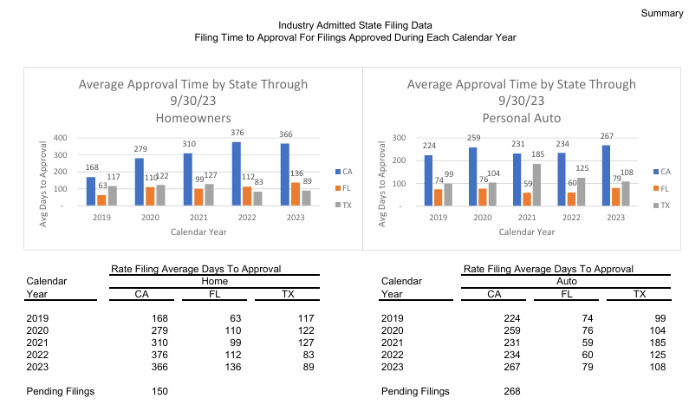
Minimal Friction: How Are We Doing?
Rate Approval Times

Slide 8
Minimal Friction: How Are We Doing?
Outside Participants
Prop. 103 Intervenors Continue to Add Months and Subjectivity to Rate Review

Slide 9
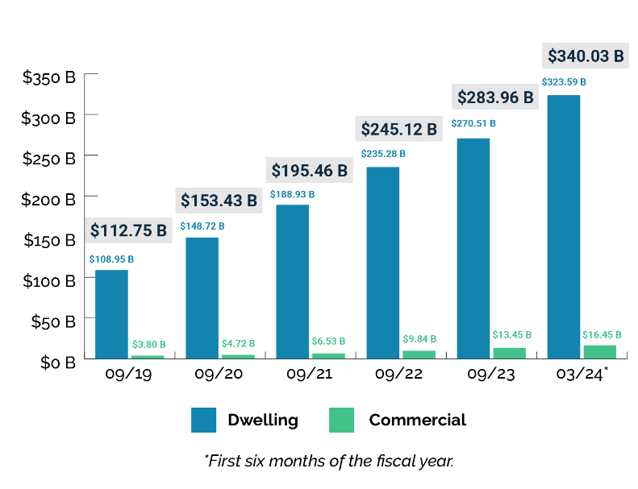
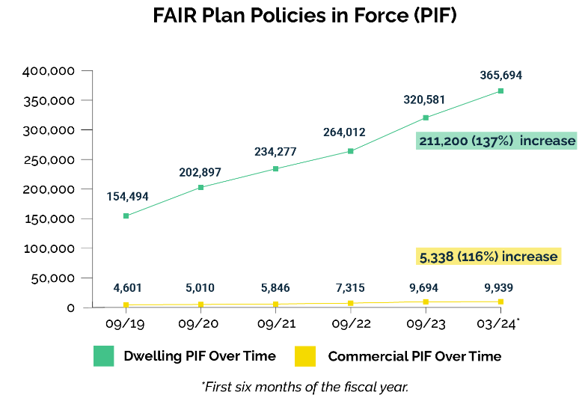
Remove Existential Threats (Property)

Slide 10
Hazard Reduction (property)
Important Upcoming Work by IBHS: “Wildfire Prepared Community”

Slide 11
Is the CA HO Market Currently “Sustainable”?
Not under current CA rules and practice.

Slide 12
What is the Commissioner’s Strategy? The “Sustainable Insurance Strategy”
Modern Rating Practices in Exchange for Growth in Higher Risk Areas
Use of Modeling and Reinsurance in Rate Filings
Maintain market share in “distressed areas”
Address FAIR Plan “depopulation.” What is the status of the “Clearinghouse.”
FAIR Plan Financial Peril
What happens after a large FAIR Plan assessment? Is CIGA a model?
Faster Rate Approvals – What happened to this part of the “Strategy”?
60-30-30
CDI Data Reconciliation Tools
Intervenors?
Require more specificity in petitions, closer attention to “substantial contribution”
Administrative Hearings
Rules for Settlement and Appointment

Slide 13
Any Progress?
Modeled Losses
CDI Workshop in April, 2024
Formal hearing in Sept, 2024
Technical questions loom, particularly the PRID
“Distressed Areas”
CDI Workshop in June, 2024
Integrated into Modeled Loss rule
FAIR Plan
CDI Signed Stipulation with FAIR Plan in Aug, 2024
Issued Bulletin outlining FAIR Plan participants’ partial/full recoupment of assessments
Reinsurance
CDI outlined concept in August, 2024 to use cat bond returns as a basis for inferring reinsurance costs
Rate Approval Times
CDI issued bulletin on 60-30-30, tied to implementation of data reconciliation tool
Intervenors
Recent Petition Rejections re Application Specific Issues & Fees
Compensation Questions/Denials
Complete Rate Application Definition
Unclear whether CDI will change current definition of “complete”

Slide 14
What about the Long Term: Mitigation?
The Science of Fire Mitigation is Getting Better, But Not Settled
Insurance Institute for Business and Home Safety (IBHS) is the primary research organization that influences insurer filings.
“Wildfire Prepared Home” provides parcel-level guidance
What Is Getting Recognized by Insurers?
Building year of home (if older, compliance with California WUI Building Code, Chapter 7A
Parcel level actions consistent with IBHS research
If home is in community with mitigation commitment (e.g., Firewise)
CDI Regulations are contrary to IBHS Wildfire Prepared Home standards
What Is Next?
Standards for Community Mitigation

Slide 15
What Should the Next Priorities Be?
Reduce Friction in Rate Reviews
Published Inputs for Trend and Development?
Interim Rates?
“Most Actuarially Sound”
Improvement to 60-30-30
Eliminate Non-Rate Matters from Rate Review Process
Clear Filing Standards / Eliminate Redundancies in Rate Review
Intervention
Previous Definition of “Proceeding” with Pre-Proceeding Compensation
Requirements for Petitions (non-duplication / novel)
Requirements for “Substantial Contribution” – Winner Pays?
Administrative Hearings
Have Real Relevancy Standards and Issue Limitation
Telematics
ACR 224, First Mandatory Factor
Super Group

