Slide 1
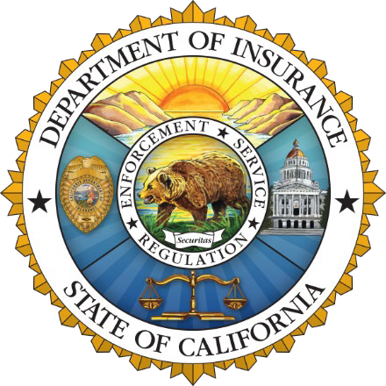
California Department of Insurance
Julia Juarez
Deputy Commissioner
Community Relations and Outreach Branch
Notes:
Good Evening everyone thank you for the opportunity to be there. We have been meeting with many of you throughout the state and it is clear to all of us that California is at an insurance crossroads.

Slide 2
The Insurance Market
Inflation is creating unprecedented financial stress to insurance markets.
Increased costs of rebuilding, supplies, materials, auto parts along with labor shortages, among other costs, are affecting insurance markets.
Reinsurance is harder to find and is costlier as catastrophes grow around the world.
As risk grows, insurance markets are contracting to protect solvency, meet financial obligations and regulatory mandates.
Natural disasters & global inflation have increased insured losses and costs worldwide like never before.
Notes:
Natural disasters and global inflation are creating stress on insurance markets. This is not just happening here – every state is experiencing these factors:
• Increased costs for rebuilding
• Labor shortages
• Insurance for Insurance companies is harder to find and costlier
• As risk increases, insurance companies are protecting their obligations to current consumers and limiting new business

Slide 3
California Context
Top 12 Companies =
85% of State’s Homeowners Market
The property insurance market in the country (specifically in large states like California) is changing quickly.
Since 2022 alone — 7 of top 12 insurance companies have paused or restricted new business despite rate increases approved or pending with Department of Insurance.
Notes:
The property insurance market is also changing quickly.
Even though 115 insurance companies are currently selling homeowners insurance, 12 insurance groups control 85 percent of the California insurance market.
Since 2022 – 7 of the top 12 insurance groups have paused or restricted new business despite rate increases approved or pending with the Department of Insurance.
So clearly this problem is complex and global in nature – affecting us here at home

Slide 4
California Context
Insurance Group and Ranking (2022) | Market Share | 2023 Rate Increases (Pending & Approved) | Major Action Since 2022
1. State Farm | 21.22% | 28.1% | Paused new policies
2. Farmers (10 companies) | 14.9% | 17.7%, 12.5% | Limited new policies to 7,000 per month
3. CSAA (2 companies) | 6.9% | 18.55% (approved 2021)
4. Liberty Mutual (6 companies) | 6.6% | 29%, 10.6%
5. Mercury | 6% | 12.6%, 7%
6. Allstate (5 companies) | 6% | 39.6% | Paused new policies
7. USAA (4 companies) | 5.7% | 30.6%, 16.5%, 6.9%, 3% | Restricted underwriting to low-risk only
8. Auto Club | 5.1% | 20%
9. Travelers | 4.2% | 21.7% | Limited new policies
10. American Family (3 companies) | 2.8% | 22.7%, 6.9%, 6.9%
11. Nationwide (2 companies) | 2.5% | 19.9%, 24.5% | Limited new policies
12. Chubb (8 companies) | 2.2% |  | Ceased writing high-value homes with higher wildfire risk, and non-renewed some high-value homes

Slide 5
California Context
Over past 10 years, homeowners insurance companies have done far worse in California than nationally.
Direct incurred loss ratio (2012-2021) Countrywide: 59.7% California: 73.9%
Direct underwriting profit Countrywide: 3.6% California: -13.1%
Direct profit on insurance transactions: Countrywide: 4.2% California: -6.1%
Direct return on net worth: Countrywide: 7% California: 0.8%
Source: NAIC Profitability Report (released January 2023)

Slide 6
How did we get here?
FAIR Plan has increased to 3% of CA market – becoming the insurer of first resort, not last resort, for many.
AM Best downgraded outlooks for Top-12 companies like State Farm, AAA, Mercury due to risk concentration in California.
Insurance companies will not write in high-risk areas, unless they can cover 100% of consumer claims, their expenses, and earn a fair return.
Rate filings are more complex and can take longer than 6 months to review.
One entity can unreasonably prolong rate filings – no other state has this.

Slide 7
Safer From Wildfires
Protect your home or business
+
Protect the immediate surroundings
+
Protect the whole community

Slide 8
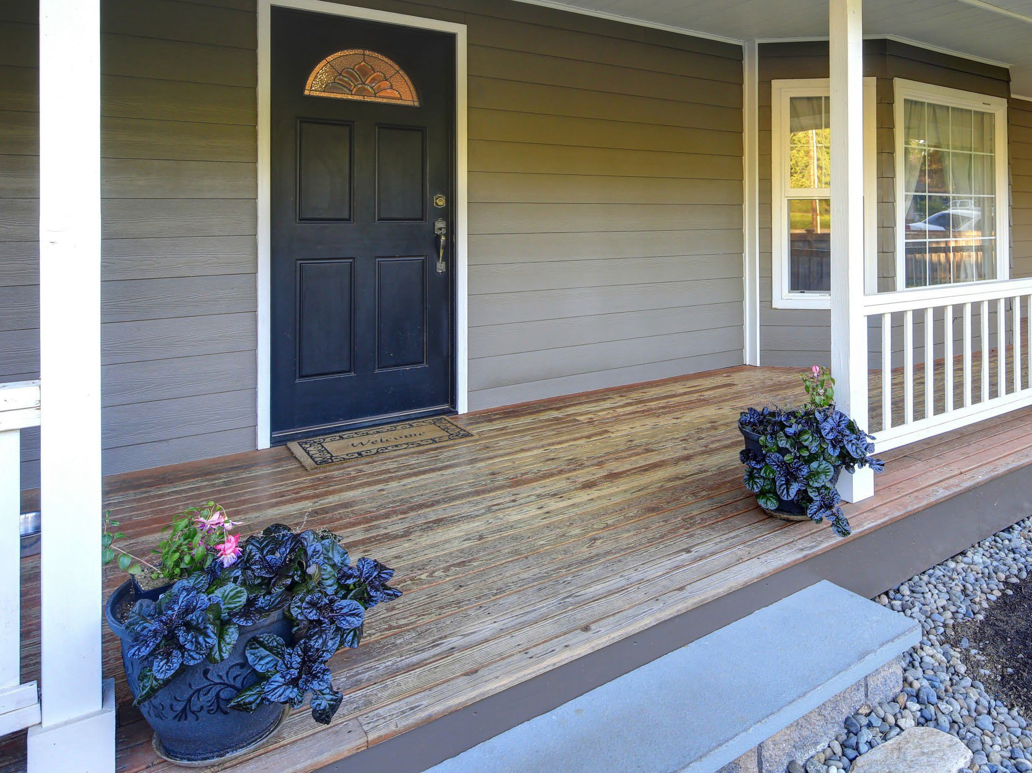
Protect your
home or business
Class A fire-rated roof
5-foot ember-resistant zone around the structure
Noncombustible 6 inches at the bottom
Ember- and fire-resistant vents
Double pane windows or added shutters
Enclosed eaves
of walls

Slide 9
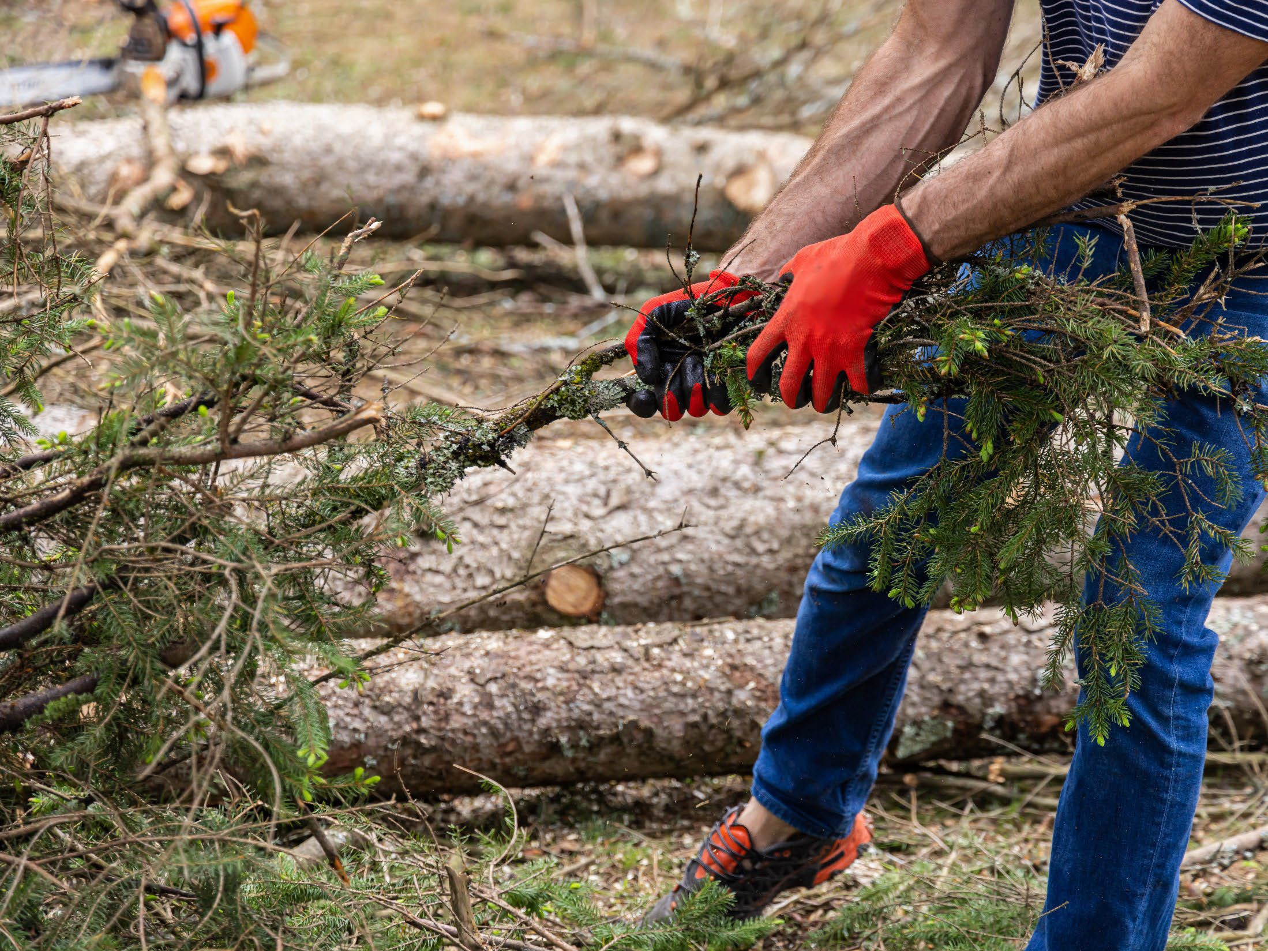
Protect the
immediate surroundings
Cleared vegetation and debris from under
Move sheds and outbuildings at least 30 feet away
Trim trees and remove brush in compliance with state and local defensible space laws
decks

Slide 10
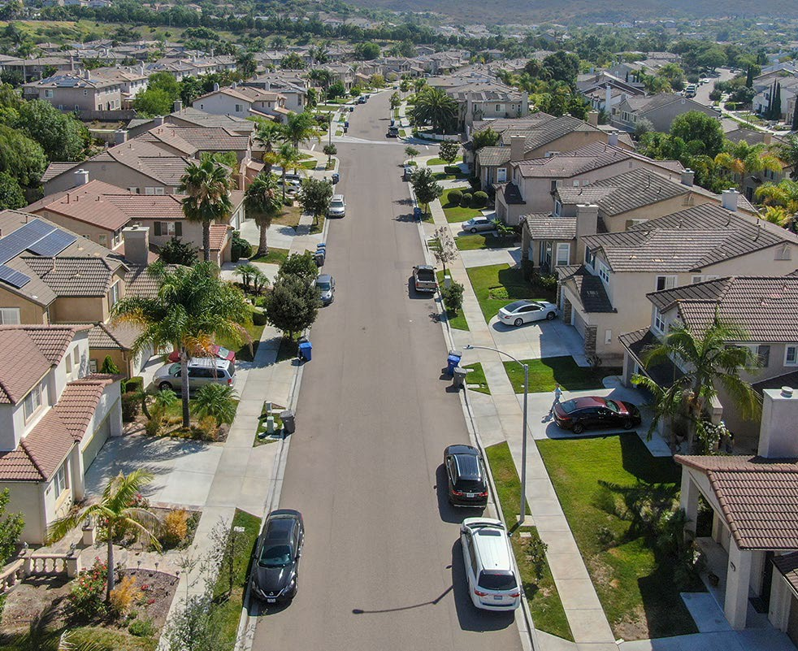
Protect the
whole community
•
•
Neighborhoods can form a Firewise USA community
Cities, counties, and local districts can become certified as a Fire Risk Reduction Community

Slide 11
CA FAIR Plan & Wildfire Risk Score
Since August the CA FAIR Plan began offering insurance discounts
The CA FAIR Plan is offering 20 million dollar coverage per location for commercial policies, including HOAs
The Wildfire Risk Score regulations allow consumers to request and appeal your property risk score

Slide 12
Modernizing Our Insurance Market:
Accessible Insurance for Californians
+
Create a Resilient Insurance Market
+
Protect Communities from Climate Change

Slide 13
California Sustainable Insurance Strategy
Cat Models/Mitigation — New models will recognize mitigation and hardening requirements to appropriately price rates and discount benefits; presently not available in current rate making process today.
California-only reinsurance costs — Protecting consumers from paying for other global catastrophes.
Modernizing FAIR Plan — Expanding commercial coverage limits to $20 million per structure closes coverage gaps for HOAs, affordable housing, and infill developments.
Insurance Availability in At-Risk Areas — Requiring insurance companies to write no less than 85% of homes and businesses in distressed areas identified by Insurance Commissioner.
Returning FAIR Plan Policyholders to Market — With first priority given to homes and businesses following “Safer from Wildfires” regulation.

Slide 14
The largest insurance reform since voters passed Proposition 103 in 1988 —
informed by thousands of
CONSUMERS in every county.
Commissioner Lara and Department of Insurance Outreach Teams have met with more than 122,000 consumers in person and virtually since 2019.
More than 2000 meetings, town halls, and events in all 58 counties of the state.

Slide 15
Questions?
1-800-927-4357
insurance.ca.gov

